Slide 1



The Mysterious Island Adventure Game
(An Interactive Text-Based Game in C)
Where choices decide your fate…
Group number-1 || Group members: Md. Rakibul Islam Sagor, Md. Jahidul Haque Abir, Chiranjeet Sarkar Amit, Kaushik Sharma, Dewan Tahsin Alam
Notes:
1

Slide 2
Mysterious Island: A Text-Based Adventure Game
1
Developed by C Programming
Presented by:
Md. Rakibul Islam Sagor (ID: 2522028042)
Md. Jahidul Haque Abir (ID: 2523059642)
2
Chiranjeet Sarkar Amit (ID: 2523703042)
Kaushik Sharma (ID: 2524251642)
Dewan Tahsin Alam (ID: 2524423642)
Group number-1 || Group members: Md. Rakibul Islam Sagor, Md. Jahidul Haque Abir, Chiranjeet Sarkar Amit, Kaushik Sharma, Dewan Tahsin Alam
Notes:
2

Slide 3

Introduction
Welcome to the Island!
This is a text-based adventure game where you'll explore a mysterious island.
The game is written in C, a powerful and fundamental programming language.
Our aim is to create an engaging story and interactive experience using simple text commands.
Group number-1 || Group members: Md. Rakibul Islam Sagor, Md. Jahidul Haque Abir, Chiranjeet Sarkar Amit, Kaushik Sharma, Dewan Tahsin Alam
Notes:
3

Slide 4




Overview of the Game
Storyline
Goal
The player finds themselves stranded on a mysterious island.
Explore different locations of the island, solve puzzles and survive.
Gameplay
Interface
At each step, the player chooses an action, and the game responds instantly. The story changes depending on the player's decisions, leading to different outcomes.
Console based text inputs and outputs.
Group number-1 || Group members: Md. Rakibul Islam Sagor, Md. Jahidul Haque Abir, Chiranjeet Sarkar Amit, Kaushik Sharma, Dewan Tahsin Alam
Notes:
4

Slide 5

Project Objective
Create an interactive console-based game using C
Learn and apply key C programming concepts
Practice designing game logic and decision-making
Improve problem-solving and creative thinking
[Group number-1 || Group members: Md. Rakibul Islam Sagor, Md. Jahidul Haque Abir, Chiranjeet Sarkar Amit, Kaushik Sharma, Dewan Tahsin Alam]
Notes:
2

Slide 6
Key Features of the game
1
2
3
Interactive Storytelling
Immersive Experience
Dynamic Locations
The game's narrative unfolds based on your decisions. Every choice you make has an impact on your journey, leading to new discoveries or potential dangers.
The use of a "typing effect" for text creates an engaging, old-school feel, pulling you deeper into the mystery, reminiscent of classic adventure games.
The island is a diverse world with multiple locations to explore, each with its own unique challenges and opportunities. The path you take and the secrets you uncover are entirely up to you.
Notes:
5

Slide 7
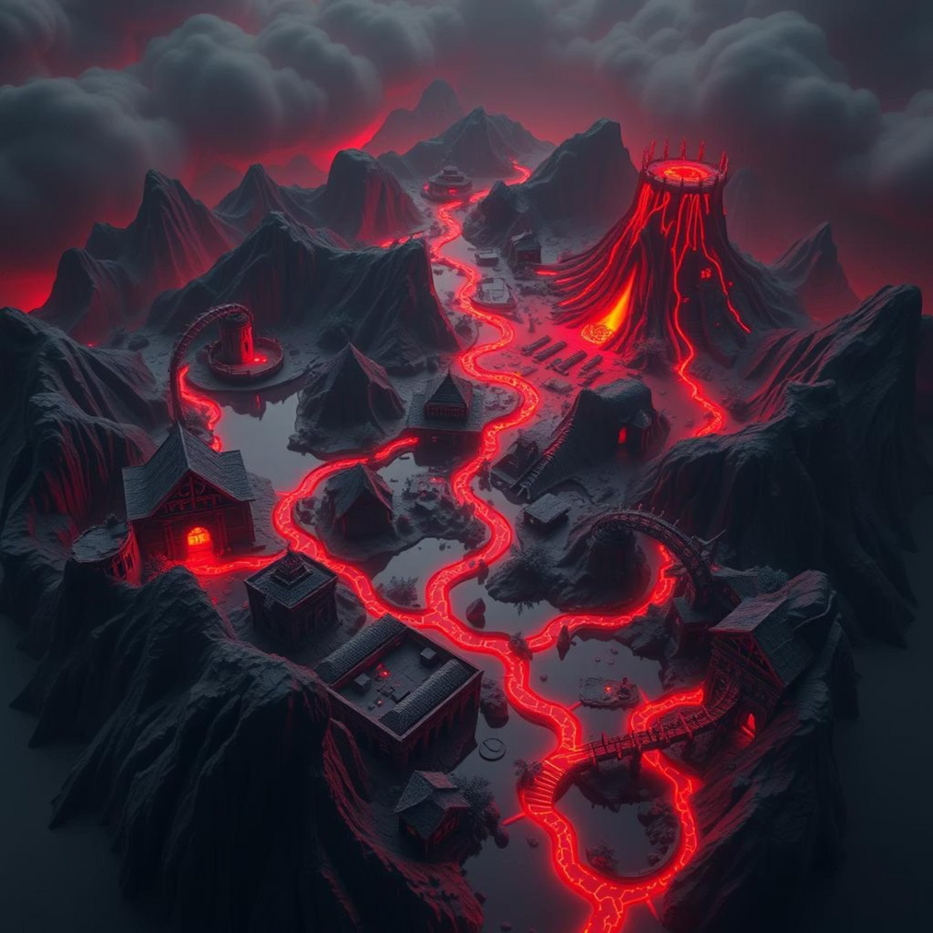
Exploring The Island
Jungle
Lush and humid, full of surprises and hidden paths.
Cave
Dark and echoing, hiding ancient secrets and valuable artifacts.
Volcano
Dangerous but potentially rewarding, holding the island's ultimate secret.
Swamp
Eerie and full of strange sounds, with treacherous terrain.
Abandoned Village
Silent but filled with cryptic clues about past inhabitants.
Your choices will decide whether you escape, win, or get stuck forever.
Group number-1 || Group members: Md. Rakibul Islam Sagor, Md. Jahidul Haque Abir, Chiranjeet Sarkar Amit, Kaushik Sharma, Dewan Tahsin Alam
Notes:
6

Slide 8






Technical Details
While loops
If-else / switch
Keep player inside game/room, ensuring continuous gameplay until conditions are met.
Handle user choices, creating branching narratives and diverse outcomes based on input.
Variables
Functions
Used for game state: mainchoice, roomchoice, inGame, inRoom to track player progress.
typeEffect() for typing animation, enhancing the immersive old-school feel.
Escape Sequences
Formatted Output
Utilized for colored text, adding visual appeal to the console interface.
ANSI color codes for better visuals, making the text-based experience more dynamic.
Group number-1 || Group members: Md. Rakibul Islam Sagor, Md. Jahidul Haque Abir, Chiranjeet Sarkar Amit, Kaushik Sharma, Dewan Tahsin Alam
Notes:
7

Slide 9

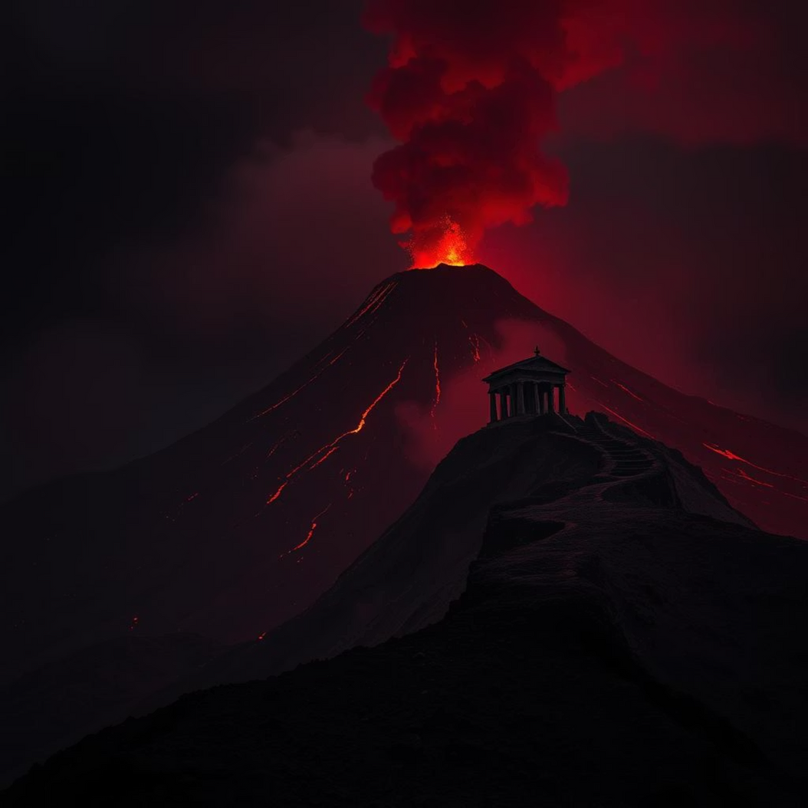
Gameplay Flow
Jungle Exploration
Winning the Game
Choose to go deeper or build shelter, influencing your immediate survival.
The Volcano's Secret
Discover a hidden waterfall cave leading to new adventures and secrets.
Climb the volcano to find an ancient temple, the ultimate challenge.
Choices influence your path on the island, creating unique narrative branches.
Unlock the island's ultimate secret and win the game, achieving true mastery.
Notes:
8

Slide 10
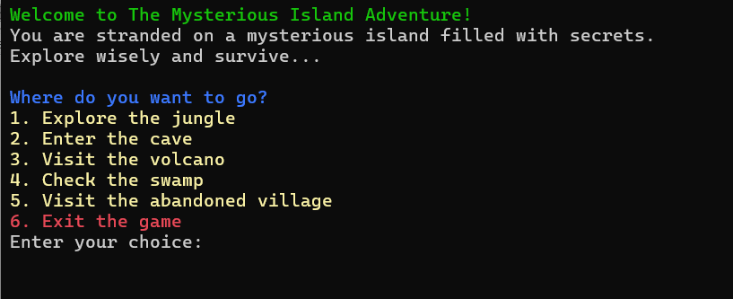
Gameplay Scenario
Start Screen:
Group number-1 || Group members: Md. Rakibul Islam Sagor, Md. Jahidul Haque Abir, Chiranjeet Sarkar Amit, Kaushik Sharma, Dewan Tahsin Alam
Notes:
9

Slide 11
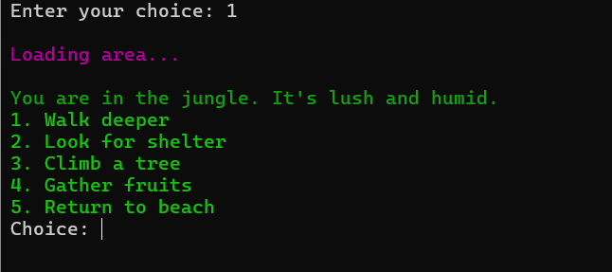
Gameplay Scenario
Sample Decision:
Group number-1 || Group members: Md. Rakibul Islam Sagor, Md. Jahidul Haque Abir, Chiranjeet Sarkar Amit, Kaushik Sharma, Dewan Tahsin Alam
Notes:
10

Slide 12
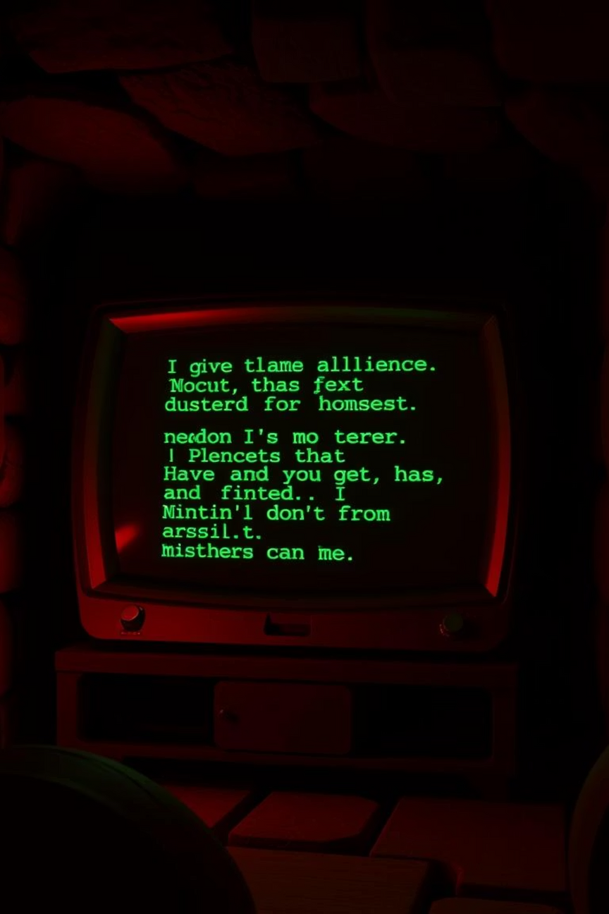
User Interaction Enhancements
Step into the world of C-based text adventures, where every choice weaves a new path and every line of text brings the story to life.
[Group number-1 || Group members: Md. Rakibul Islam Sagor, Md. Jahidul Haque Abir, Chiranjeet Sarkar Amit, Kaushik Sharma, Dewan Tahsin Alam]
Notes:
11

Slide 13




Challenges Faced
Navigating Complexity
Managing multiple connected locations without confusion, ensuring a seamless player experience.
Robust Input Handling
Handling invalid inputs gracefully to prevent crashes and provide clear feedback to players.
Engaging Narrative
Crafting a captivating storyline with only text, relying on vivid descriptions and compelling choices.
Balancing Freedom
Striking the right balance between difficulty and player freedom to keep the game challenging yet enjoyable.
[Group number-1 || Group members: Md. Rakibul Islam Sagor, Md. Jahidul Haque Abir, Chiranjeet Sarkar Amit, Kaushik Sharma, Dewan Tahsin Alam]
Notes:
12

Slide 14

Future Scope
Add a saving and loading system for persistent gameplay.
Include sound effects and ASCII art for richer visuals and immersion.
Expand the map with more locations and intricate pathways.
Implement random events, like a sudden storm or unexpected encounter.
Introduce inventory and health mechanics for deeper RPG elements.
Integrate riddles requiring players to combine puzzles and clues for unique challenges.
[Group number-1 || Group members: Md. Rakibul Islam Sagor, Md. Jahidul Haque Abir, Chiranjeet Sarkar Amit, Kaushik Sharma, Dewan Tahsin Alam]
Notes:
13

Slide 15
Conclusion
Conclusion: This project significantly improved our skills in C programming, game design, and problem-solving. We gained invaluable experience in managing game states, handling user inputs efficiently, and crafting interactive stories that engage players in a text-based environment.
[Group number-1 || Group members: Md. Rakibul Islam Sagor, Md. Jahidul Haque Abir, Chiranjeet Sarkar Amit, Kaushik Sharma, Dewan Tahsin Alam]
Notes:
14

Slide 16
THANK YOU
[Group number-1 || Group members: Md. Rakibul Islam Sagor, Md. Jahidul Haque Abir, Chiranjeet Sarkar Amit, Kaushik Sharma, Dewan Tahsin Alam]
Notes:
15

Slide 17
Demo Time!
Let's have a look
[Group number-1 || Group members: Md. Rakibul Islam Sagor, Md. Jahidul Haque Abir, Chiranjeet Sarkar Amit, Kaushik Sharma, Dewan Tahsin Alam]
Notes:
1

Slide 18
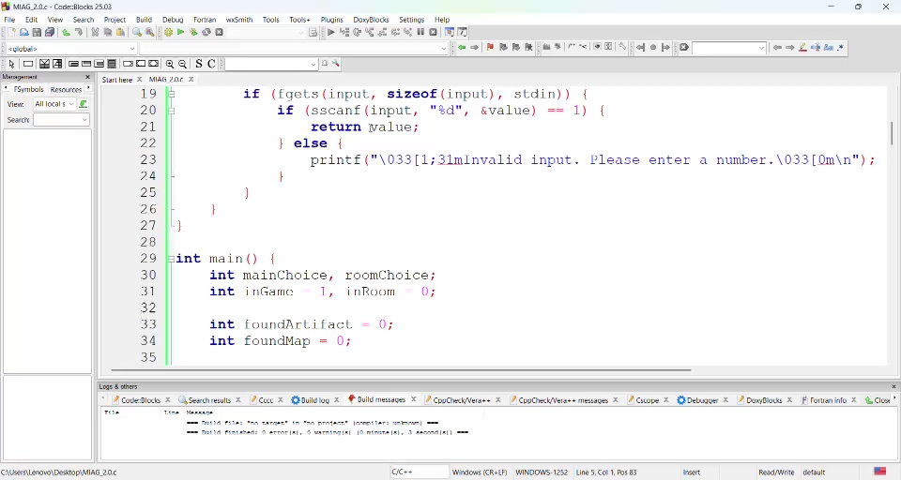
Game Demo
[Group number-1 || Group members: Md. Rakibul Islam Sagor, Md. Jahidul Haque Abir, Chiranjeet Sarkar Amit, Kaushik Sharma, Dewan Tahsin Alam]
Notes:
1

